Slide 1
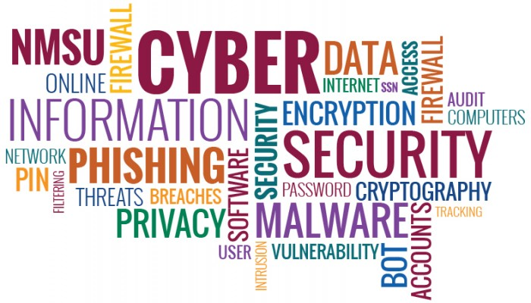
Security Awareness
How attacks occur, and how you can help prevent them

Slide 2

Who am I?
Jacob Kelley
Bachelors Degree – Information Systems Security
Bachelors Degree – Computer Network Management
3 Years Experience Teaching IT Security and IT Networking
4+ Years Experience Conducting HIPAA Security Assessments
15+ Years Experience in IT Industry

Slide 3

General IT Security Statistics
84 Million Samples of New Malware Detected in 2015
9 Million more than 2014
Directed Attacks Grew by 40% from 2014 to 2015
From first spam email, it takes only 82 seconds for someone to become a victim
RansomWare increased 113% from 2014 to 2015
Expected to be largest threat in 2016
Estimated $5 million per year lost to ransomware infections
Detected 4 million samples of ransomware Q2 2015 (1.2 million new)
Compared to 1.5 million total in 2013 (Fewer than 400,000 new)
Ransomware-as-a-service Gaining in Popularity – could further accelerate trend

Slide 4
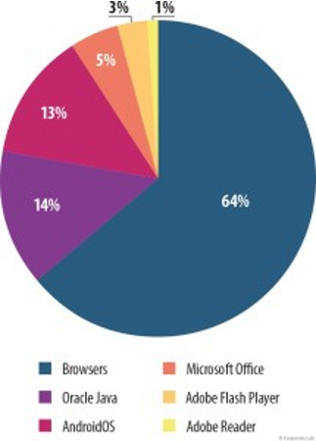
Vulnerable Applications, by popularity (Q1, 2015)
Browser-based infections 64%
Includes Internet Explorer exploits
Includes email links
Java-based infections 14%
Android OS 13%
Microsoft Office 5%
Adobe Flash Player 3%
Adobe Reader 1%

Slide 5
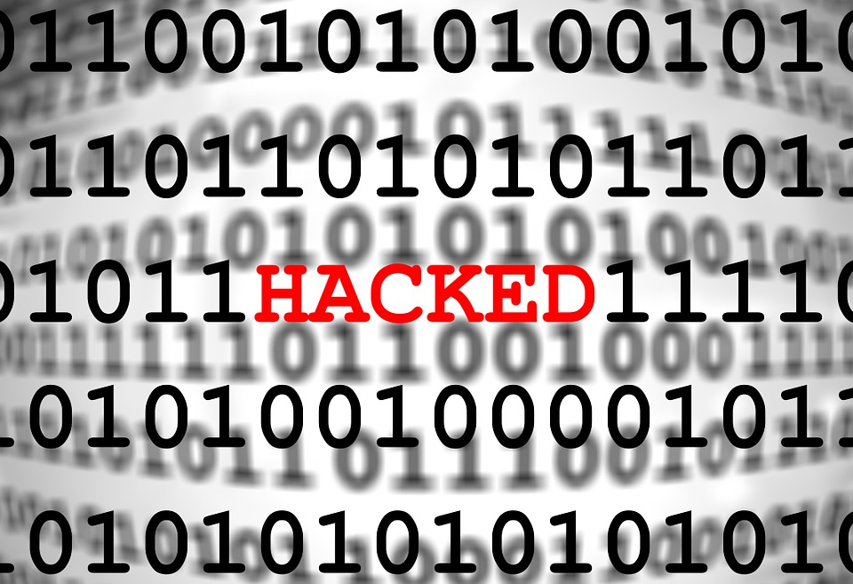
RansomWare – Infection Vectors
Email
User receives email offering software or system update – when user accepts the malware infection begins
User has to click on a link to initiate process
Malvertising
Hackers infect global advertisements – when user clicks on a link of what appears to be a legitimate advertisement the process is initiated and encryption starts
Zero-Day Exploit
User visits website that is infected with an unknown security exploit, triggering the download and installation of malware without user input

Slide 6
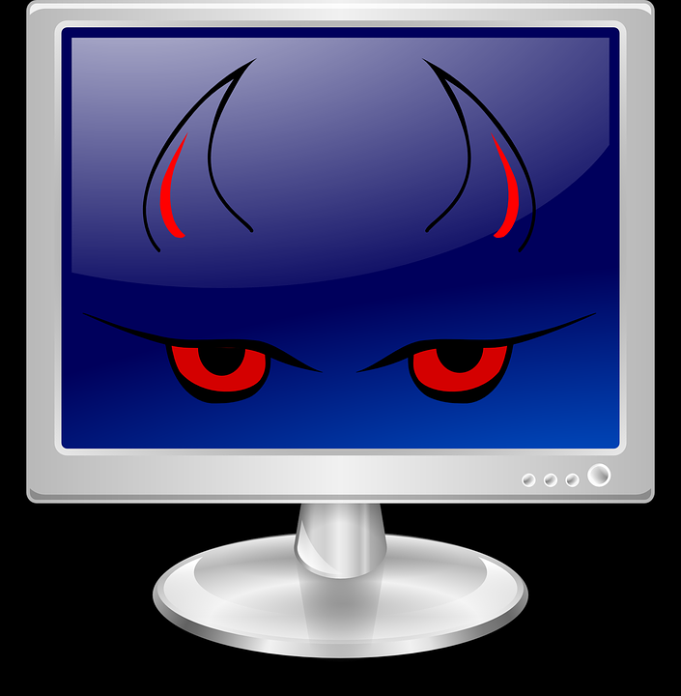
Ransomware – Malware activity
Once infected, malicious software begins encrypting all files the user has access to
Encryption is the process of randomizing data, only allowing it to be put back when issued a specific key/password that the malware author charges for
When finished encrypting, the user is given a message, allowing a set number of days (usually about 3) to follow a process in which the cybercriminal is paid
If the user does not pay the ransom in the allotted time, their data is lost
Of course, if suitable backups are available users are able to restore from that
With new ransomware, backups are detected and destroyed

Slide 7
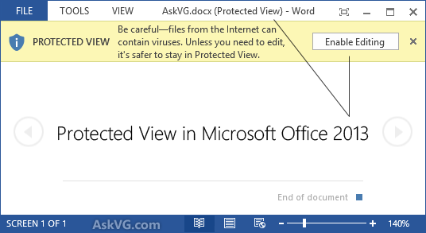
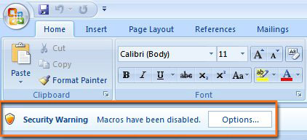
Microsoft Office Security
Protected View
Read-only mode for files that have been downloaded from untrusted sources
Built-in protection to prevent viruses from spreading on a network
Attachments and/or Macros disabled
Microsoft has implemented security controls to slow down the spread of malicious software, particularly macro-based malware
Just like email attachments and malicious website links, Microsoft Office documents can contain malicious code to download further malware and infect your PC
To mitigate this problem, Microsoft disables these links by default

Slide 8

Malware Prevention
Be Skeptical, always
Do not click on any emails or attachments you do not recognize
Avoid suspicious websites altogether, such as ads/links that often appear at the right or bottom of a website
Do not ever accept software updates that are triggered by a website or email
This includes Windows 10, Adobe Flash, and Java
If you are even slightly suspicious of something, do not click any links, and immediately alert your supervisor and/or IT contact
We can easily and safely scan links and let you know if they are safe or not
Be vigilant
Due to the rapidly evolving threats, and the asymmetrical nature of offensive security, you can never expect security measures to protect you completely from attacks
Always question things, and educate yourself about threats
If you note that your software is out of date, notify IT
Do not attempt to update it yourself
Where possible, always save documents to the server
In the worst case scenario, you can recover documents and only lose minimal amounts of work

